Slide 1
Challenges in Global Forecasting
February 2015
Round table discussion with Industry participants

Slide 2
Introduction
Senior Director, Global Strategic Market insights for Takeda Oncology 2009-2015, President of PBIRG 2014
BSc degree in Chemistry, worked in the laboratory of Nobel Laureate Dr Richard Heck.
M.B.A. degree with concentration in Market Research and Operations Management from Drexel’s LeBow College of Business
Previously positions in Market Research, Business Planning, Contract Management, and R&D Planning with Novartis, Warner-Lambert, and Ipsen Pharmaceuticals
Evolved Takeda Oncology’s market research and forecasting focus from a US-only to a global one
Stephen Murdock, MBA
Moderator

Slide 3
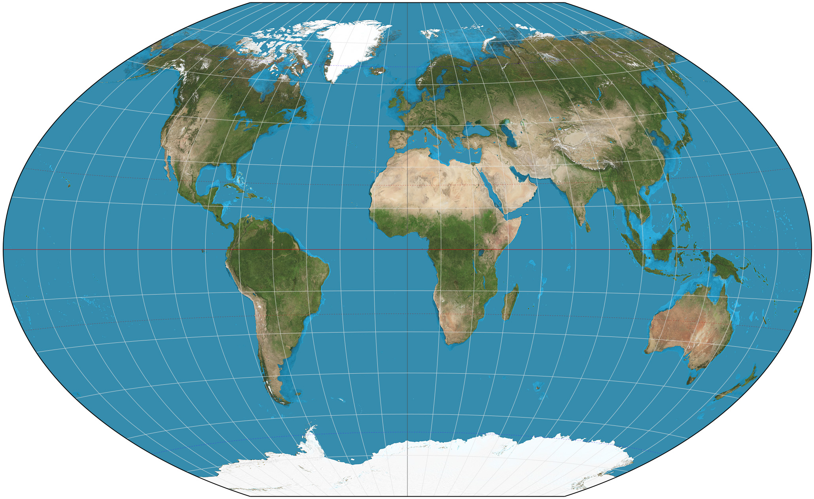
Forecast Components & Considerations
Epidemiology
Patient flow vs. rough estimations
Factoring in non-diagnosed and non-treated patients
Differing population characteristics by country
Reference countries where data is limited
Accuracy, especially in western vs. emerging countries
Source of data: registries, papers, agency databases, etc
Prevalence vs. Incidence
Link between operating & strategic forecasts
Difficulty in finding information for orphan diseases

Slide 4
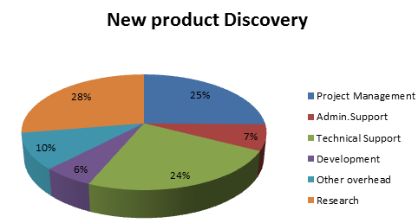
Forecast Components & Considerations (cont’d)
Product Share
Uptake curve; using analogs or not
Market definition understood by all
Across indications; across countries
Shifting competitive environment: new products, generics
Marketing power driving competitors
Adjusting from preference to demand share
Consideration of growing awareness

Slide 5
Forecast Components & Considerations (cont’d)
Adherence / Persistence
Programs to improve
Changes over time to Length of therapy
Price
Reference pricing; order of launch
Initial price; price decline
Gross Sales
Discounting to net
Free product: samples, named patient programs
Inventory flux

Slide 6
Forecast Topics of Interest as Suggested by Round-Table Participants
General
Accurate global forecasting for new products
Forecasting challenges and pitfalls
Different approaches & techniques
Systems for forecasting
Managing forecast applications
Link between operations & strategic forecasts
Assumptions
Calibration of data
Forecasting with patients vs. units
Techniques other than conjoint to estimate peak share
Integrating market research within forecasts
Utilizing company data
How to utilize qualitative information
Best practices in adjusting preference to demand share
Payer-Physician Link
Country considerations:
When to Extrapolate US data to other countries
Understanding local market influences
Balancing between country differences without complexity
Roll out of individual countries to global
Communication
Accomplishing buy-in from Global

Slide 7
For additional information, please contact:
Stephen Murdock
CharlesView Solutions, LLC
An innovative, independent market research consultancy
Office: 508-417-7575
E-Mail: stephen.murdock@charlesview.solutions
Website: www.charlesviewsolutions.com

